Slide 1

Credit EDA Case Study
BY: DEEPSHIKHA JAIN

Slide 2
EDA Case Study
OBJECTIVE: This case study aims to identify patterns which indicate if a client has difficulty paying their installments which may be used for taking actions such as denying the loan, reducing the amount of loan, lending (to risky applicants) at a higher interest rate, etc. This will ensure that the consumers capable of repaying the loan are not rejected. Identification of such applicants using EDA is the aim of this case study.
In this case study we performed the following steps:
Data Understanding
Data cleaning
Data analysing
Firstly, we make the understanding with data. Get to know about their columns description and finds the idea about irrelevant columns and target columns.
Secondly, we have performed the data cleaning on application _data dataframe. There are many irrelevant columns present in the data frames so it is better to remove those once and proceed with the clean data.
There are 307511 rows and 122 columns in the dataset, it is very difficult to look at each column one by one and dig out NA values so, we find out all columns where missing values are more than 30%. We remove the columns having NA values more than 30%

Slide 3
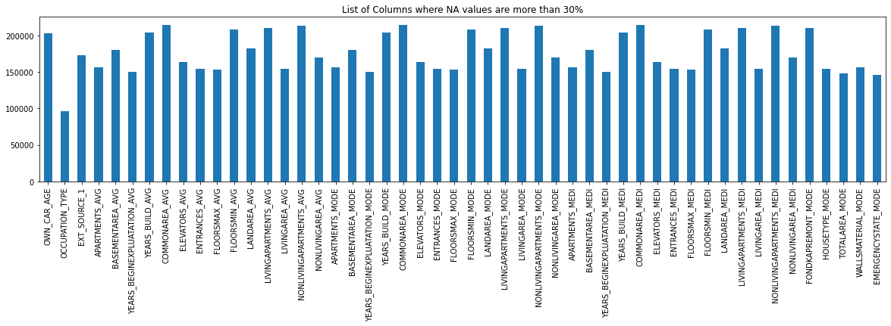
Number of columns having null value more than 30%= 50
By the above plot we develop a better insights.

Slide 4
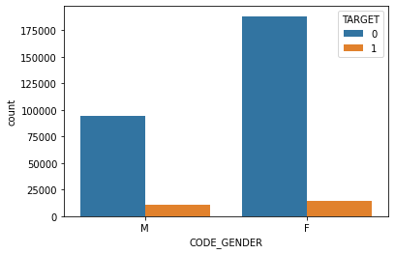
We also checked the columns for same value if whole column contains only one unique than we can drop that as well. As it does not create any difference in analysis part. Fortunately, Application_data dataframe we do not get any such column.
After cleaning the data we proceed to data analysis part.
We focus on ‘TARGET’ variable (1 - client with payment difficulties: he/she had late payment more than X days on at least one of the first Y installments of the loan in our sample, 0 - all other cases).
By this variable we conclude that clients with target variable 1 might create problem in future.
We calculate the default percentage and observed that the default rate is 8%.
After that we play with categorical variables by find all the categorical variable and find the default rate across them.
The Code gender column contains XNA values so we replace XNA with suitable value
Female Clients are slightly more in defaulter category than Male clients.

Slide 5
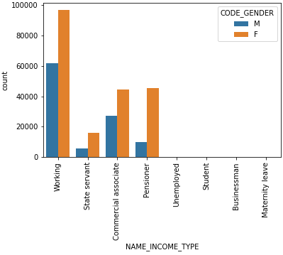
Points to be concluded from the above graph:
For income type 'working', 'commercial associate', and 'pensioner' the number of credits is higher than others.
For this Females are having more number of credits than male.
No credits status for income type 'student', 'Businessman' and 'Maternity leave'.

Slide 6
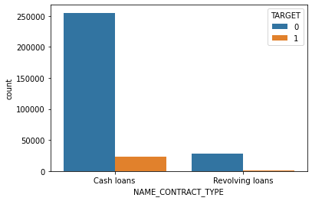
As per above figure, we can say that most people take loan as Cash loans but, less number of defaulters are in revolving loans as compared to cash loans.

Slide 7
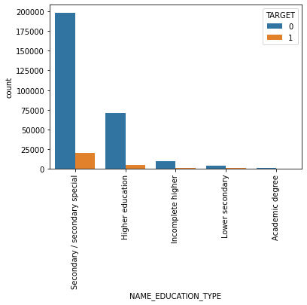
From above plot it is true that Secondary education and higher education have mostly applied for loan and pay loan on time but also have more defaulters too. Incomplete Higher, Lower secondary, Academic degree people are less applying for loan but only few are come under defaulter’s category.

Slide 8
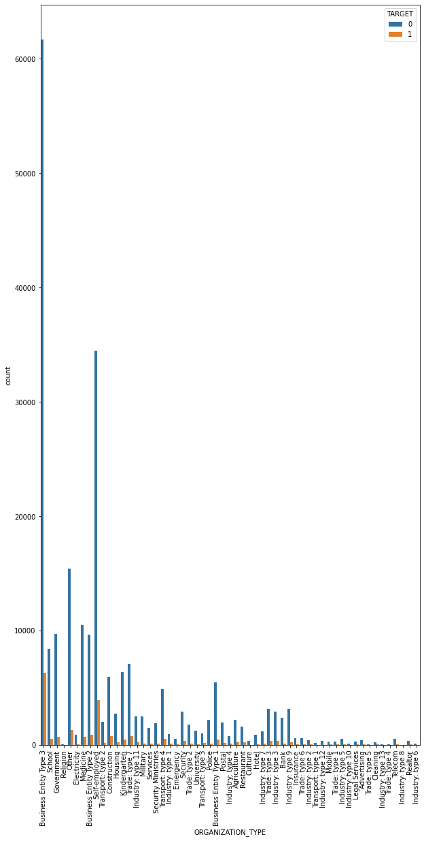
Clients which have applied for credits are from most of the organization type ‘Business entity Type 3’, ‘Self employed’, ‘Other’, ‘Medicine’ and ‘Government’.
Less clients are from Industry: type 8,type 6, type 10, religion and trade type 5, type 4.

Slide 9
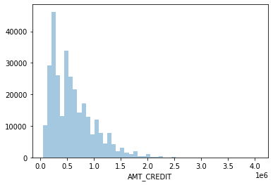
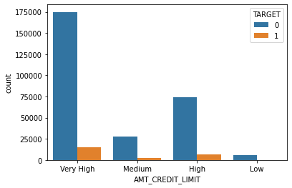
Let's bin the Credit amount variable into small, medium, high, very high.
As we can see that very high and high credit amount count to be taken is high but in that defaulter rate are also high.

Slide 10
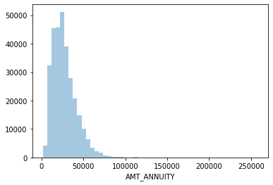
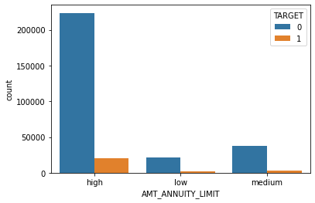
Let's bin the Annuity amount variable into low, medium and high
As we can see from above figure that counts of people who have Amount Annuity limit of high are more but they have more defaulters too.

Slide 11
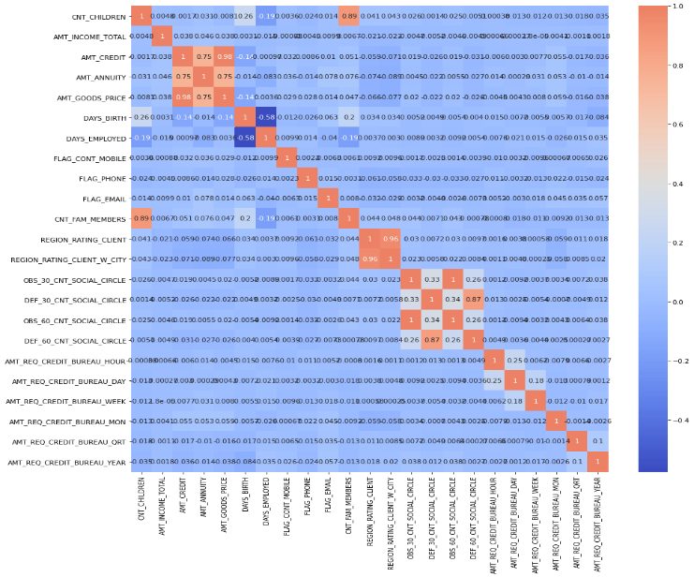
Correlation for target 1
From above figure, we can see the correlation between all the variables:
“AMT_CREDIT” variable is highly correlated with the “AMT_GOODS_PRICE”.
This means higher the loan amount is for the goods that are highly priced.
Credit amount is inversely proportional to the number of children client have, means Credit amount is higher for less children count client have and vice-versa

Slide 12
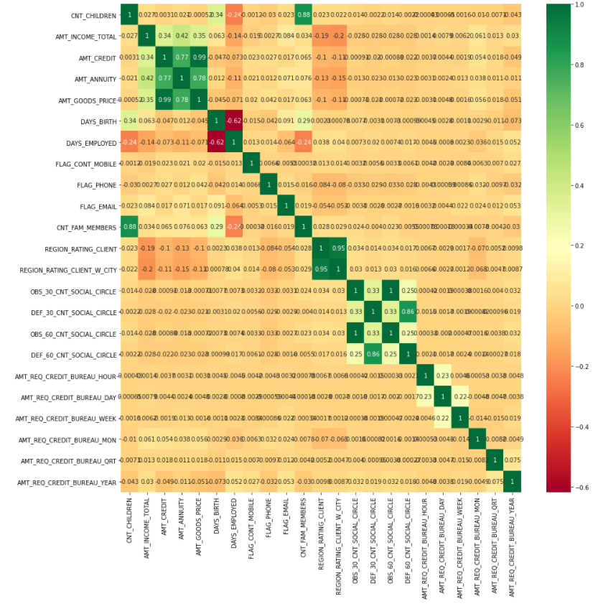
Correlation for target 0
This heat map for Target 0 is also having quite a same observation just like Target 0.

Slide 13
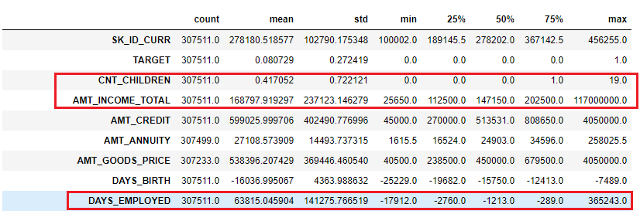
Columns having outliers
Outlier is a data points that differs significantly from other observations.
Outliers are noticed in CNT_CHILDREN, AMT_INCOME_TOTAL & DAYS_EMPLOYED.
We can identify that following columns: CNT_CHILDREN, AMT_INCOME_TOTAL & DAYS_EMPLOYED from above figure with outliers values which are having huge difference compared to the regular intervals of other values.

Slide 14
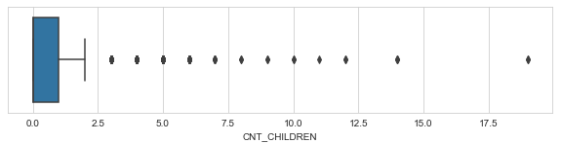
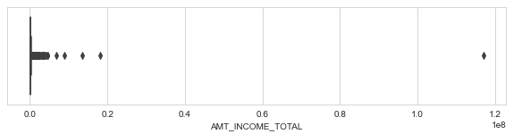
Explanation using box plots for outlier values:
CNT_CHILDREN: Now a day, 19 children per person is quite difficult. Hence, treat as an outlier.
AMT_INCOME_TOTAL:
The max value is 9 digits which seem to be manual error. Hence we will treat this as an outlier.

Slide 15
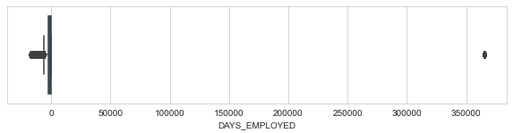
DAYS_EMPLOYED:
There is a huge difference among max amount, mean and 75th percentile, hence, consider as outliers.

Slide 16
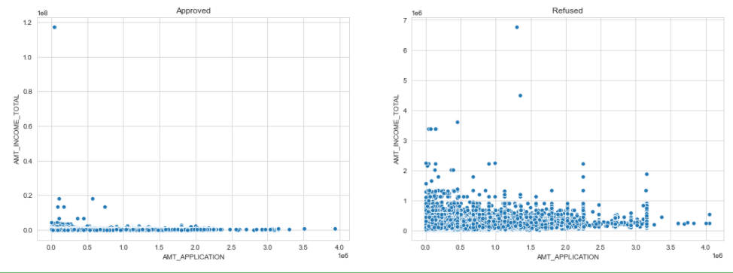
Higher the loan amount is refusing more loan application.
The loan is approving for the clients whose income is less.

Slide 17
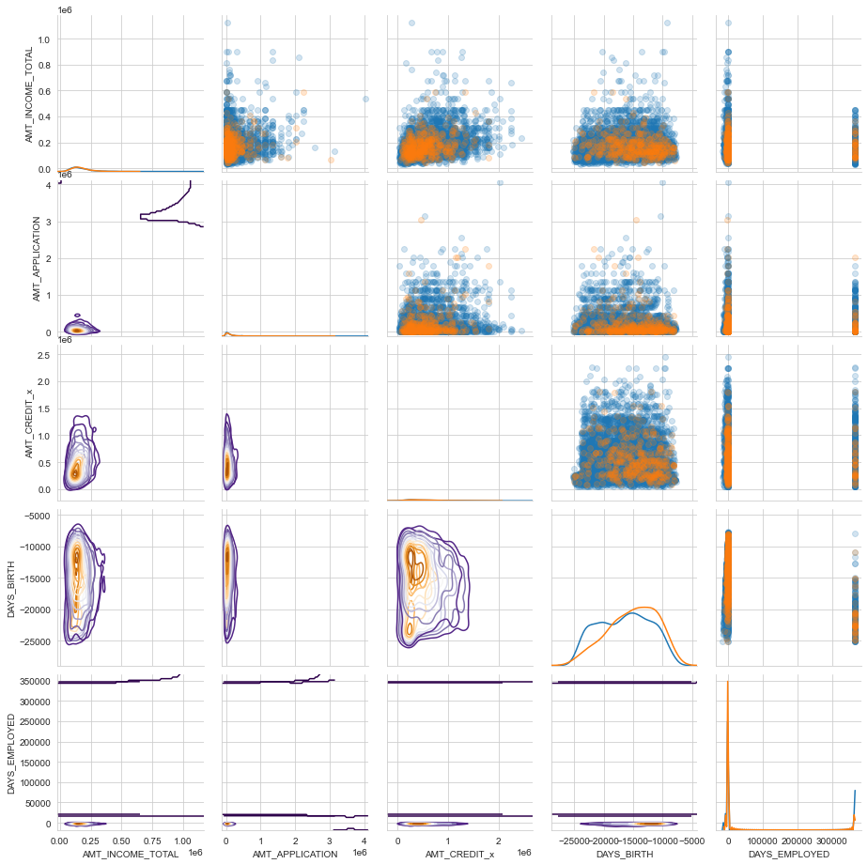
Let’s create a pairplot and pairgrid to have a graphical analysis of the most important features of the dataset. As the original dataset is quite large, we take a sample of it such that we remove all the rows that have NaN and then take a random sample of 5000 points.
We have a 6x6 grid in pairplot as TARGET is explicitly considered via the coloring scheme (i.e., hue). In this pairgrid TARGET is denoted by the hue. Orange is TARGET=1 (default), and Blue is TARGET=0 (no default).
The pairgrid can be explained as follows:
Upper triangle: This is a scatter plot between the two variables in the X & Y axes, and has the TARGET variable as a different hue.
Diagonal: This is a kde plot of the distribution of each variable.
Bottom triangle: This is a kde plot.
Looking at DAYS_BIRTH and DAYS_EMPLOYED, we can see that for TARGET=1 (i.e., orange) there is a high negative correlation. It is harder to make similar comments for the correlations between the other variables and that of the TARGET.

Slide 18
THANK YOU

